Slide 1

2021 and 2022 NFL Season Data Analysis
Brett Fortuna
Full Stack Data Analytics Bootcamp

Slide 2
Objective
Who dominates their position?
Which teams have the best offense?
Which part of the field offers the most reward?

Slide 3
Methodology
Installed the nfl-data-py package into Python to get all NFL play by play data from years 2021-2022
Converted to CSV and cleaned data in Excel
Produced graphics in Tableau
Brough graphics into PowerPoint to make a better presentation

Slide 4
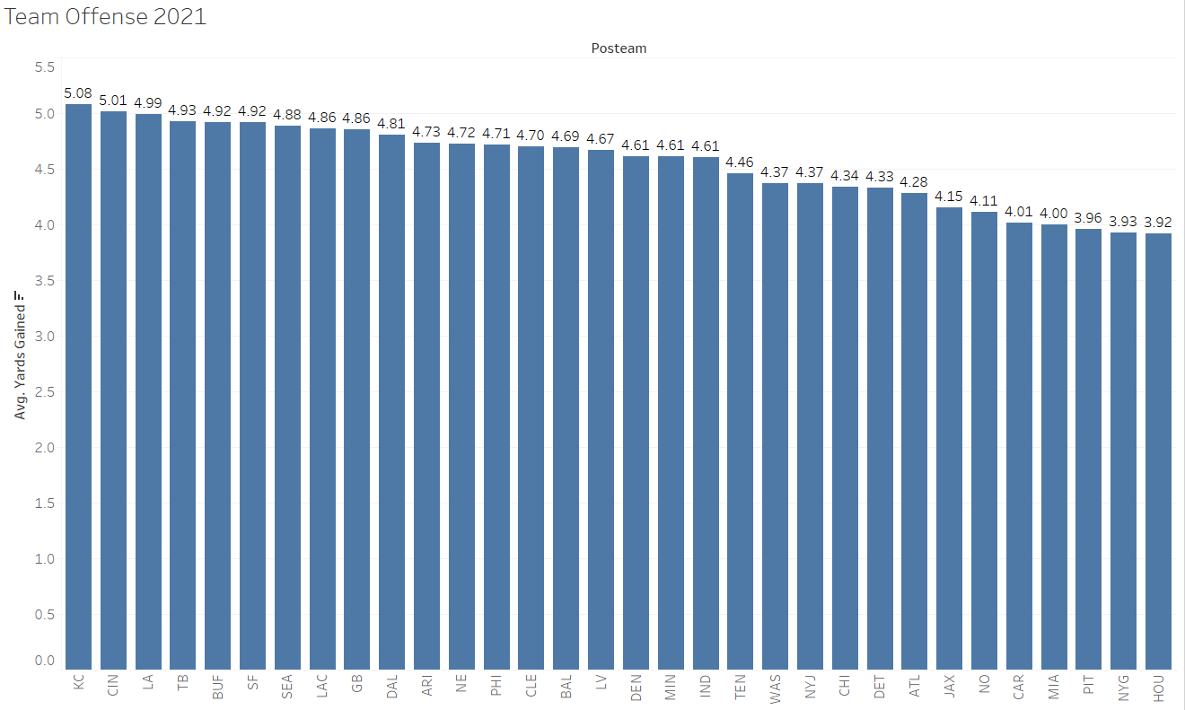
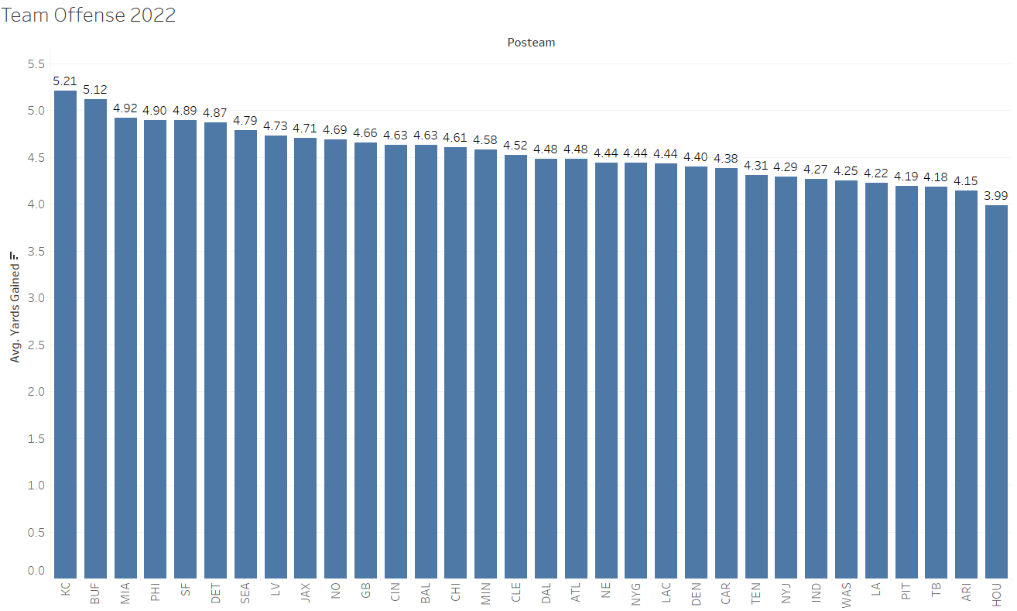
Year by Year Breakdown 2021-2022 Yards per Play
Which teams made drastic improvements?
Dolphins 4.00 4.92
Hired Mike McDaniel
Eagles 4.71 4.90
The Jalen Hurts effect
Which teams regressed?
Bengals 5.01 4.63
Jamarr Chase and Tee Higgins injuries
Bucs 4.93 4.18
TB12 getting old and Chris Godwin injury

Slide 5
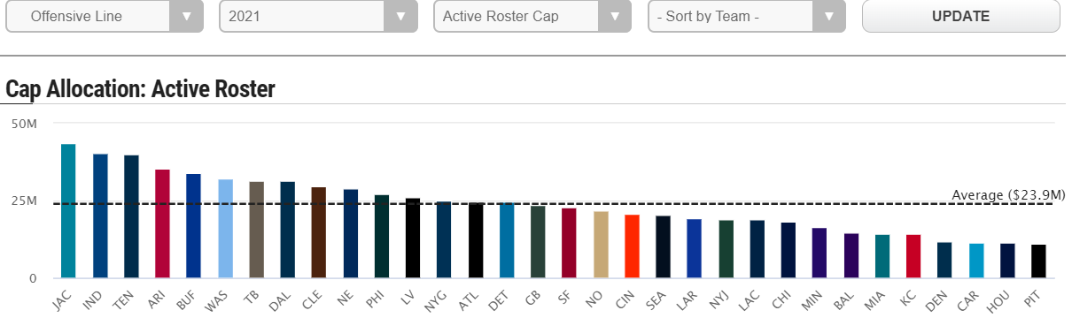
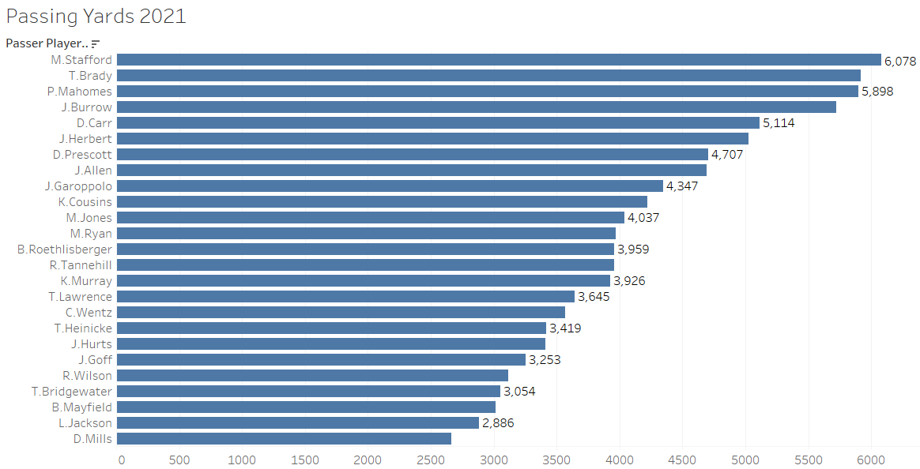
2021 Passing Data
Does higher paid OL equate to better passing stats?
Stats say NO!
Veterans dominating
Good teams pass the ball
Rams, Bucs, Chiefs, Bengals, Raiders, Cowboys, Bills, 49ers all made playoffs. All in top 10 in passing for 2021

Slide 6
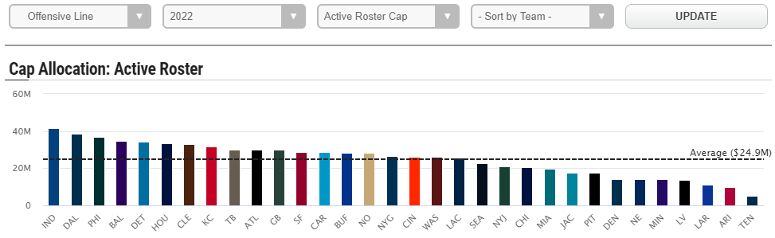
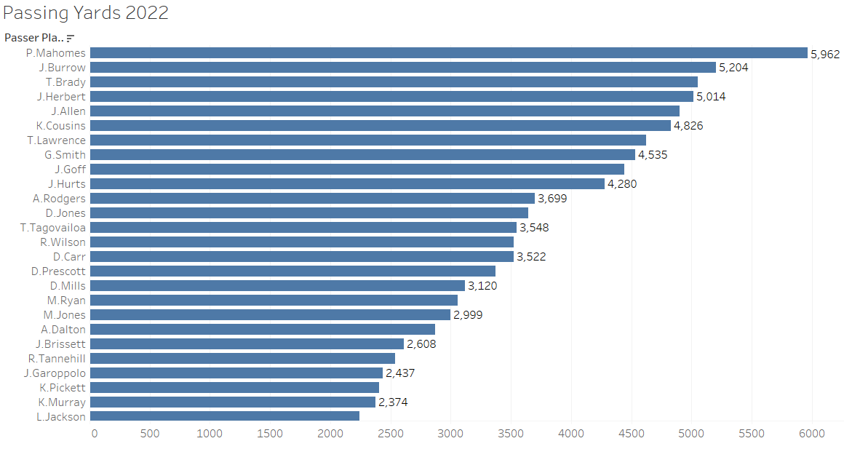
2022 Passing Data
Does higher paid OL equate to better passing stats?
Stats say YES!
Younger guys coming alive
Good teams are still passing the ball

Slide 7
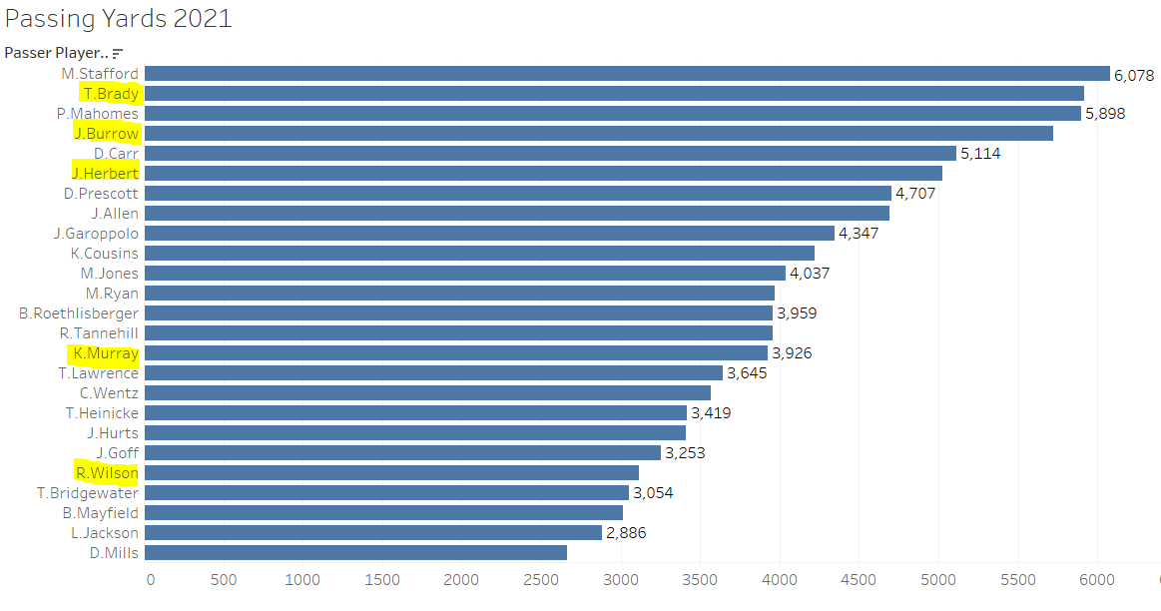
Does Height Matter for QB?
Tallest:
Justin Herbert: 6’6”
Joe Burrow: 6’4”
Tom Brady: 6’4”
Shortest:
Kyler Murray: 5’10”
Russell Wilson: 5’11”
Tua Tagovailoa: 6’0”
NFL Average: 6’2”

Slide 8
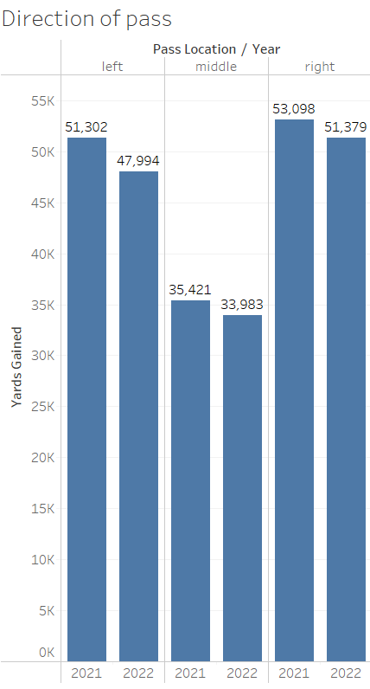
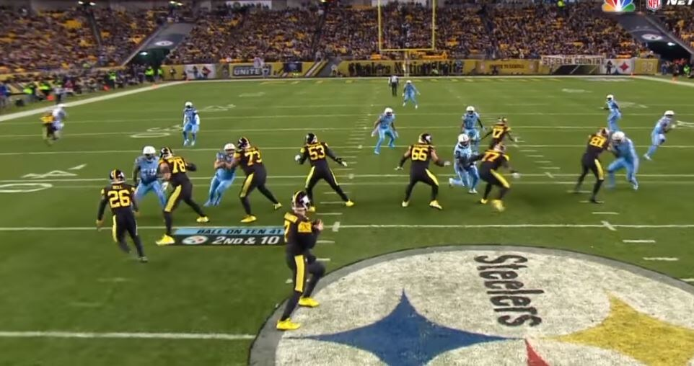
2021-2022 Direction of Pass
Decrease in yards from 2021 to 2022
Middle of field always congested, tough to break free
Top end WR play on the outsides

Slide 9
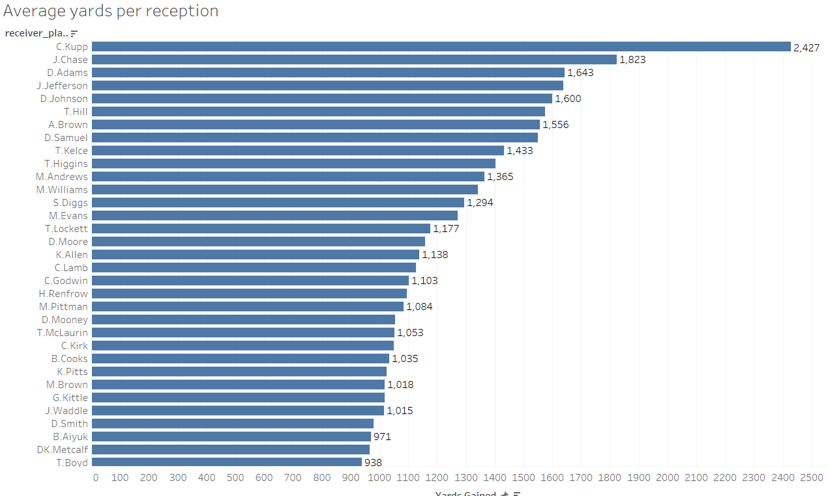
2021 Receiving Data
Cooper Kupp for MVP
Direct correlation to Matt Stafford leading league in passing
Travis Kelce isn’t even a WR, yet ranked #9

Slide 10
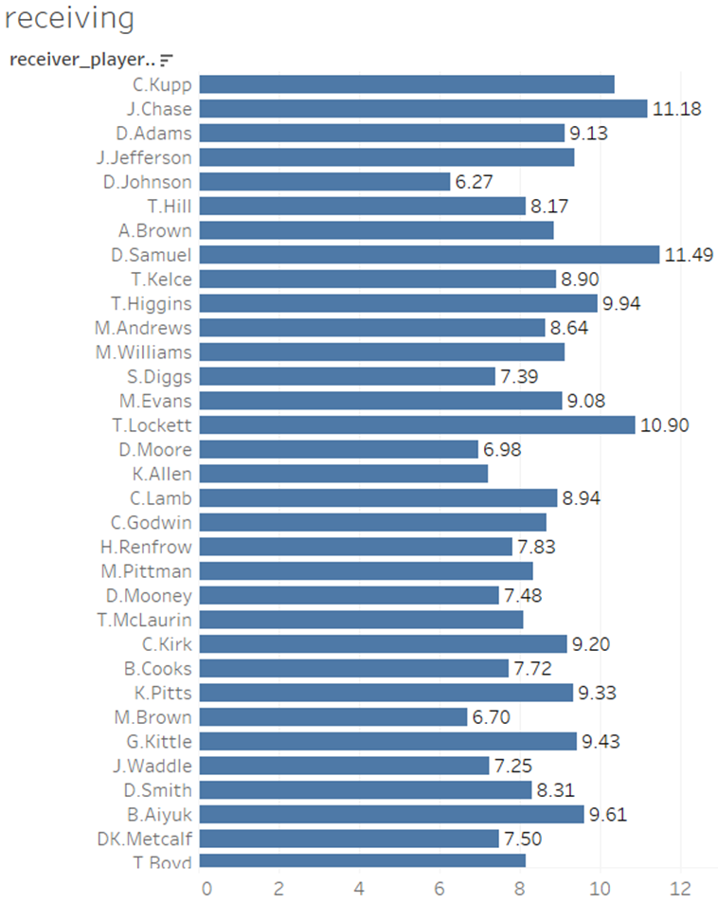
2021 Receiving Data Yards Per Catch
Deebo Samuel very talented YAC (yards after catch)
Jamarr Chase added a huge spark to the Cincy offense in his rookie year
Diontae Johnson is king of PPR (point per reception, catches a lot but not a lot of yards) fantasy football

Slide 11
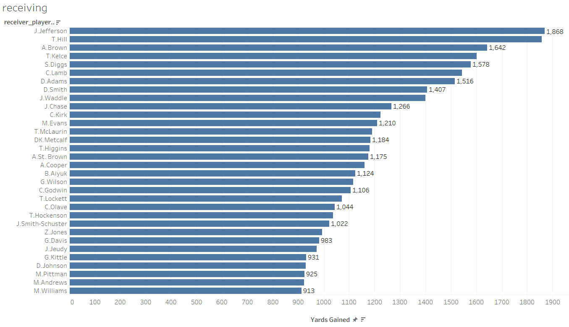
2022 Receiving Data
Two Dolphins in the top 10. Mike McDaniel changing things
Garrett Wilson and Chris Olave only rookies on this list.
Only 29 rookies in NFL history have ever broken 1,000 yards

Slide 12
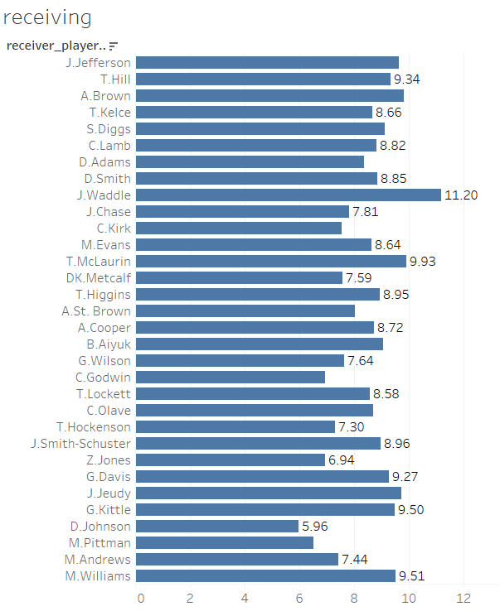
2022 Receiving Data- Yards per Reception
Jaylen Waddle is explosive as they come
Even with QB change, Diontae Johnson still averaging a low yards per reception

Slide 13
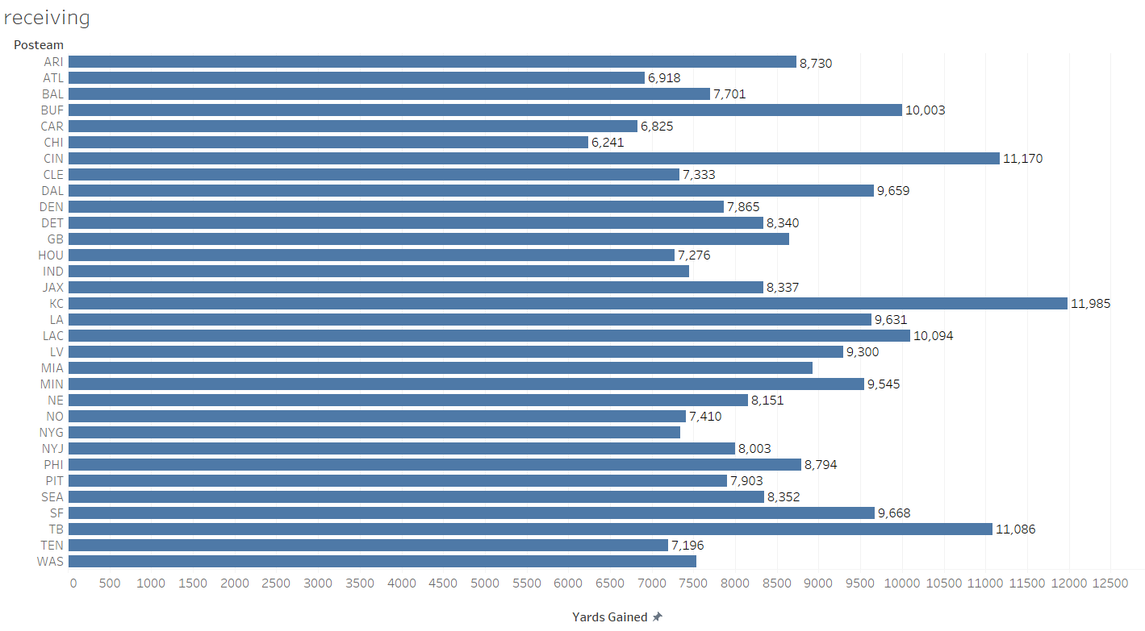
Recap of 2021-2022 Receiving Data
Really good teams throw the ball!
Combined wins of top 3 teams over two years (KC, TB, Cincy): 69
Combined wins of bottom 3 over two years (ATL,CAR,CHI): 35

Slide 14
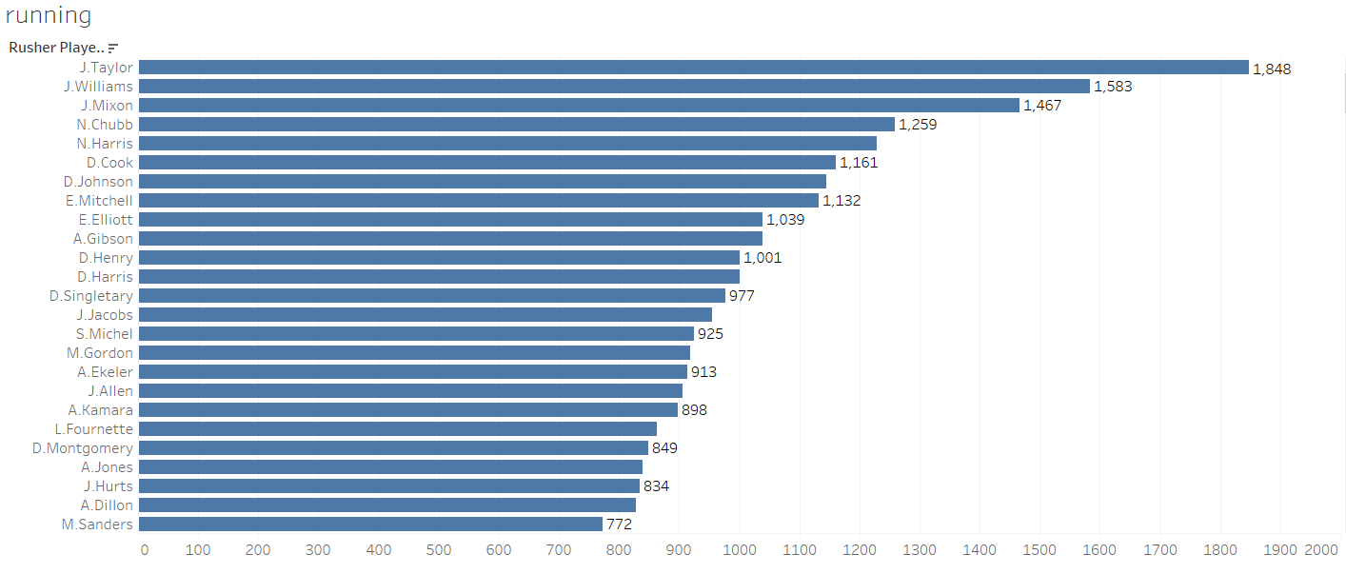
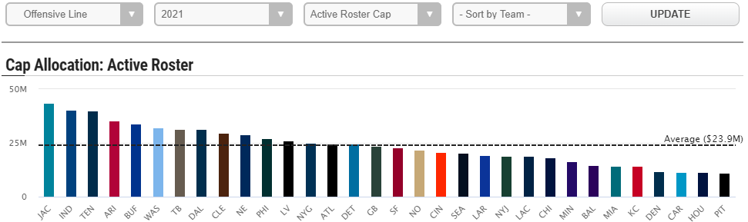
2021 Rushing Data
Jonathan Taylor breakout season
Jonathan Taylor led the league, and his team (Colts) spent 2nd most on OL. Colts spent well above the league average

Slide 15
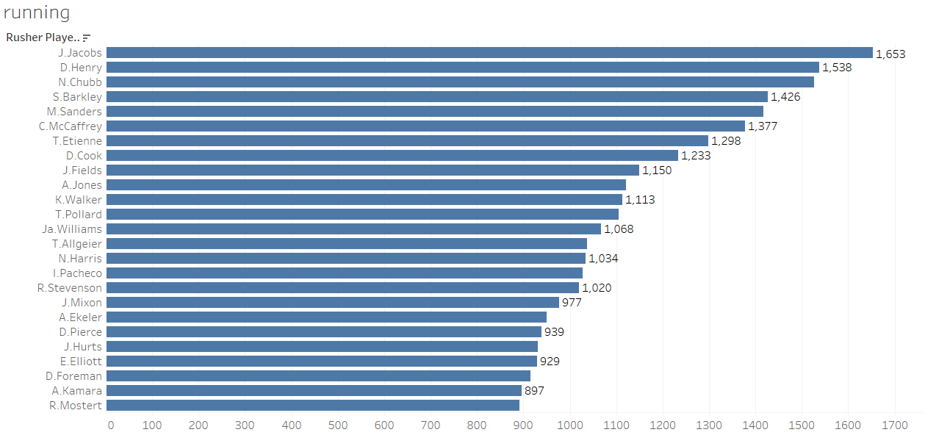
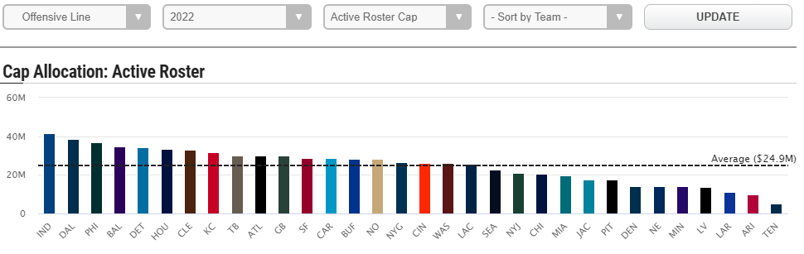
2022 Rushing Data
Josh Jacobs increased his rushing yards by 89.6% while having the 4th lowest paid OL.
Jonathan Taylor got hurt so couldn’t repeat his success from last year. Clearly talent matters as no other Colt came in top 25 even with highest paid OL.
Derek Henry ran for 1,538 yards with cheapest OL. He is a special talent

Slide 16
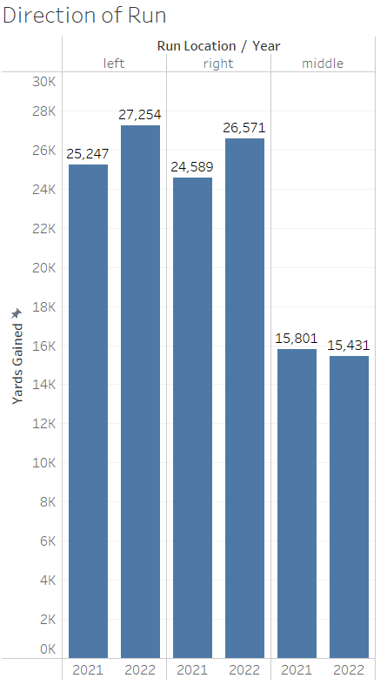
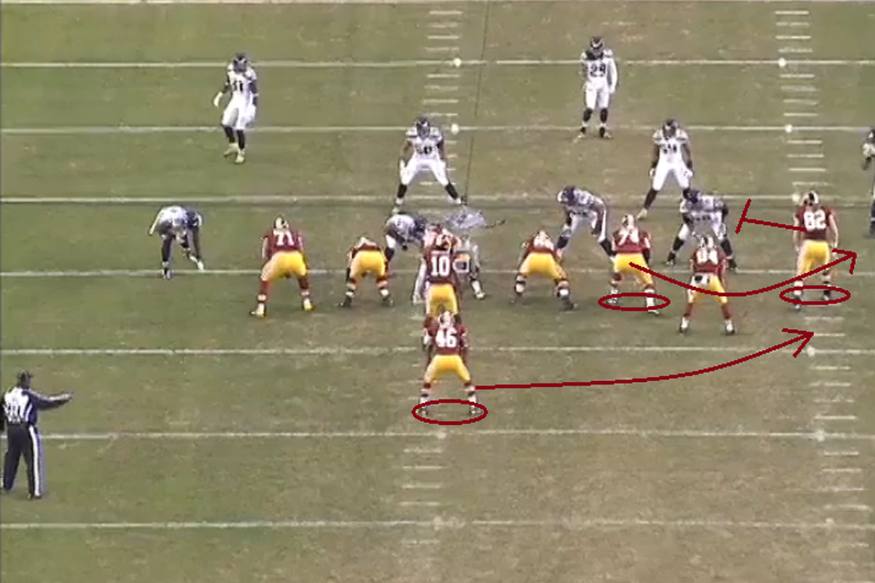
2021-2022 Rushing Direction
Teams need to run to the outside. Look at that difference!
The highest paid OL are typically the LT and RT who are on the outside. That is no coincidence
Important to not that rushing increased YOY whereas passing decreased YOY

Slide 17

What size do you want your RB to be?
Want to avoid injury
Want to be small enough to hit the gaps
Want to have top end speed
Aaron Jones and Kenneth Walker are only two players on the list who are 5’9” or under
HOT TOPIC: When should you draft a RB? Avg on this graphic is 3.17 rounds.

Slide 18
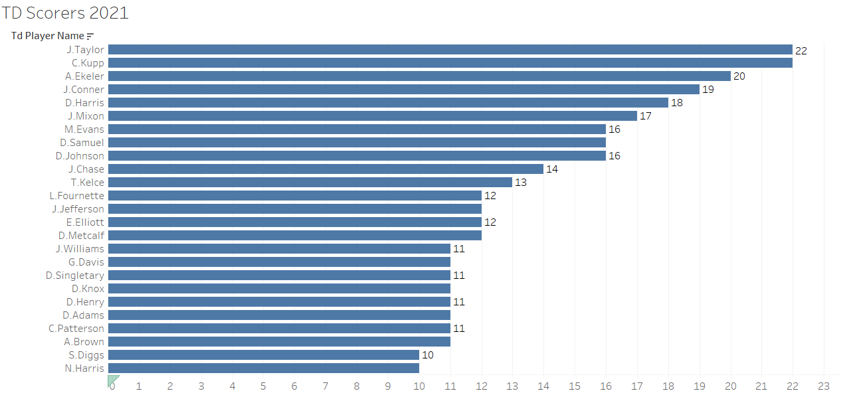
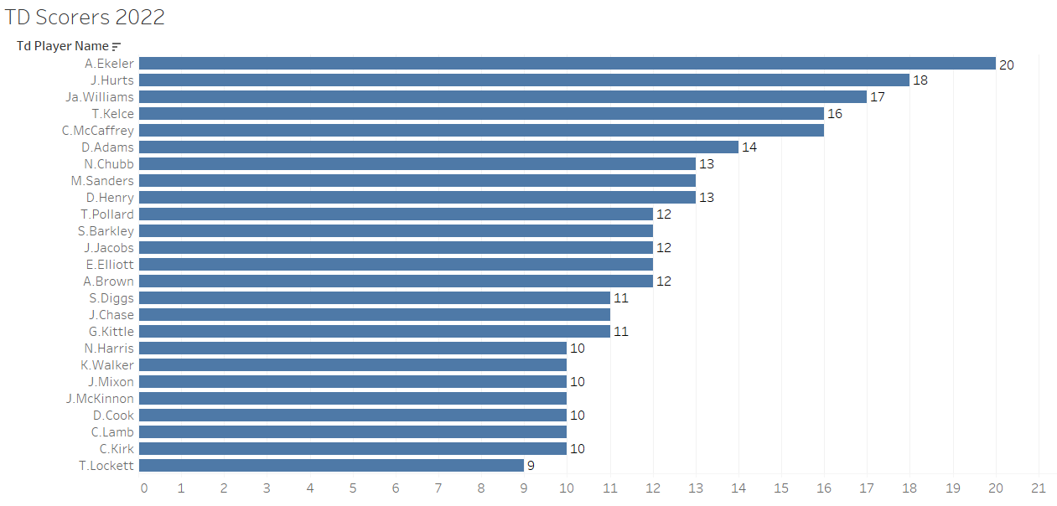
Touchdown Scoring 2021 vs 2022
Key Takeaway: Get Austin Ekeler on your fantasy team! 40 TD over last 2 years
Jalen Hurts had 18 rushing TD as a QB!
Note: This is only rushing and receiving data. No passing

Slide 19
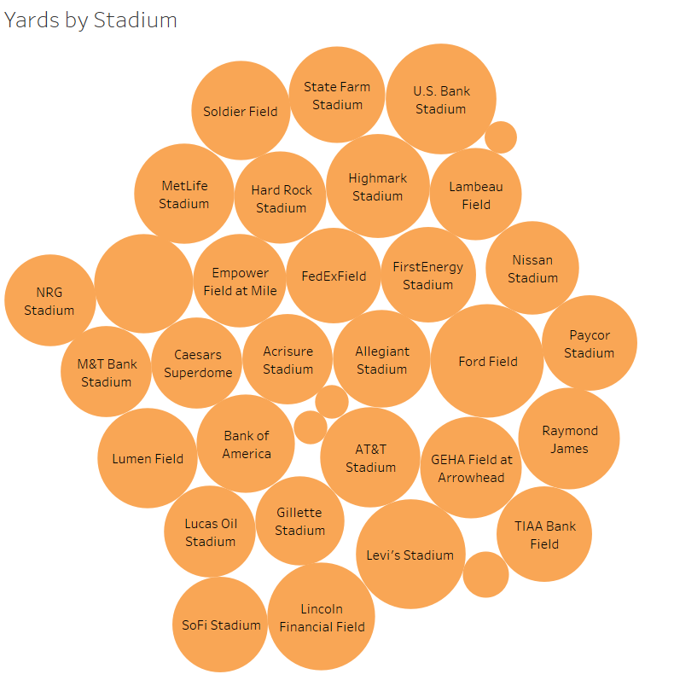
Which Stadium Produced the Most Yards?
Top:
Ford Field- Lions 8,317
US Bank- Vikings 7,906
Levi's Stadium- 49ers 7,772
Bottom:
M&T Bank Stadium- Ravens 5,354
Acrisure Stadium- Steelers 5,268
Gillette Field- Patriots 5,125
Two of top three are in a dome
Bottom are all outside located in the NE
*2022 only*

Slide 20
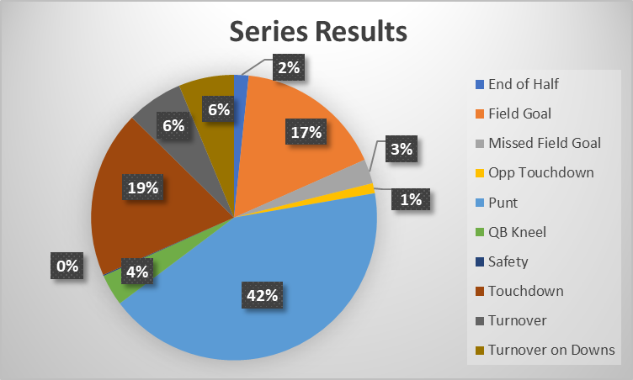
Series Results 2021 vs 2022
Teams only score Touchdowns 19% of the time. Very important to score TD’s and not kick FG’s
Average home score: 23.2
Average away score: 21.0
per www.cleanuphitter.com

Slide 21
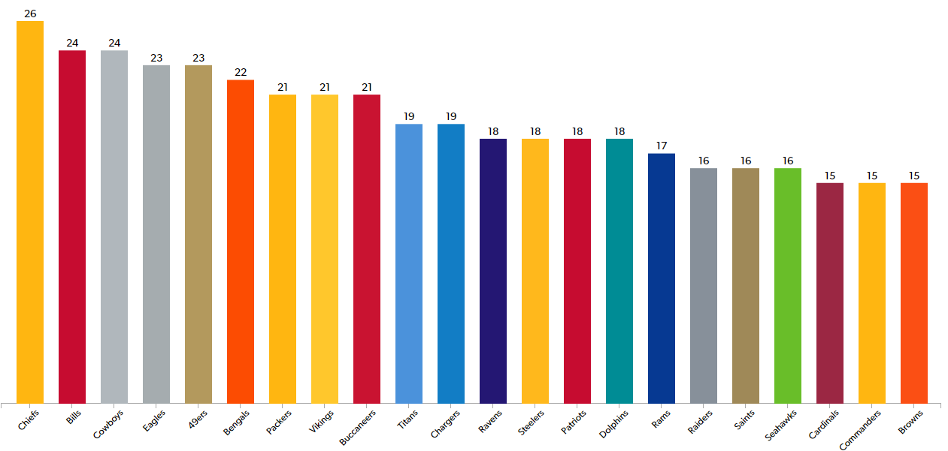
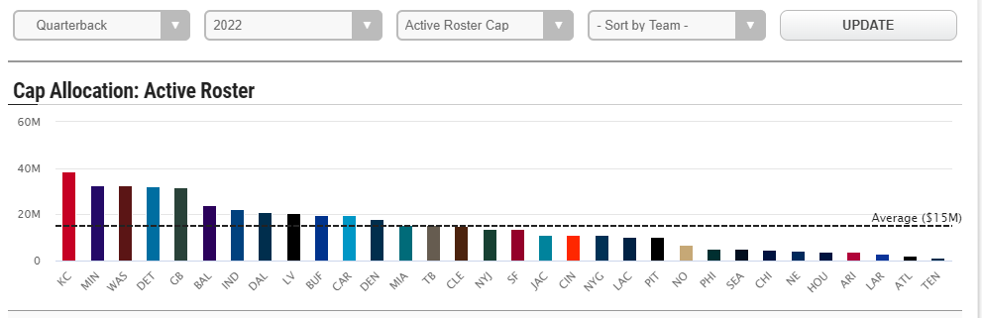
NFL Wins 2021-2022
When looking at the data I shared above, you will notice that the best players belong to teams with the most wins.
QB play is the factor. Success in the NFL is a direct correlation of how good your QB is. Just ask the Chiefs, Bills, and Eagles.
PAY YOUR QB

Slide 22
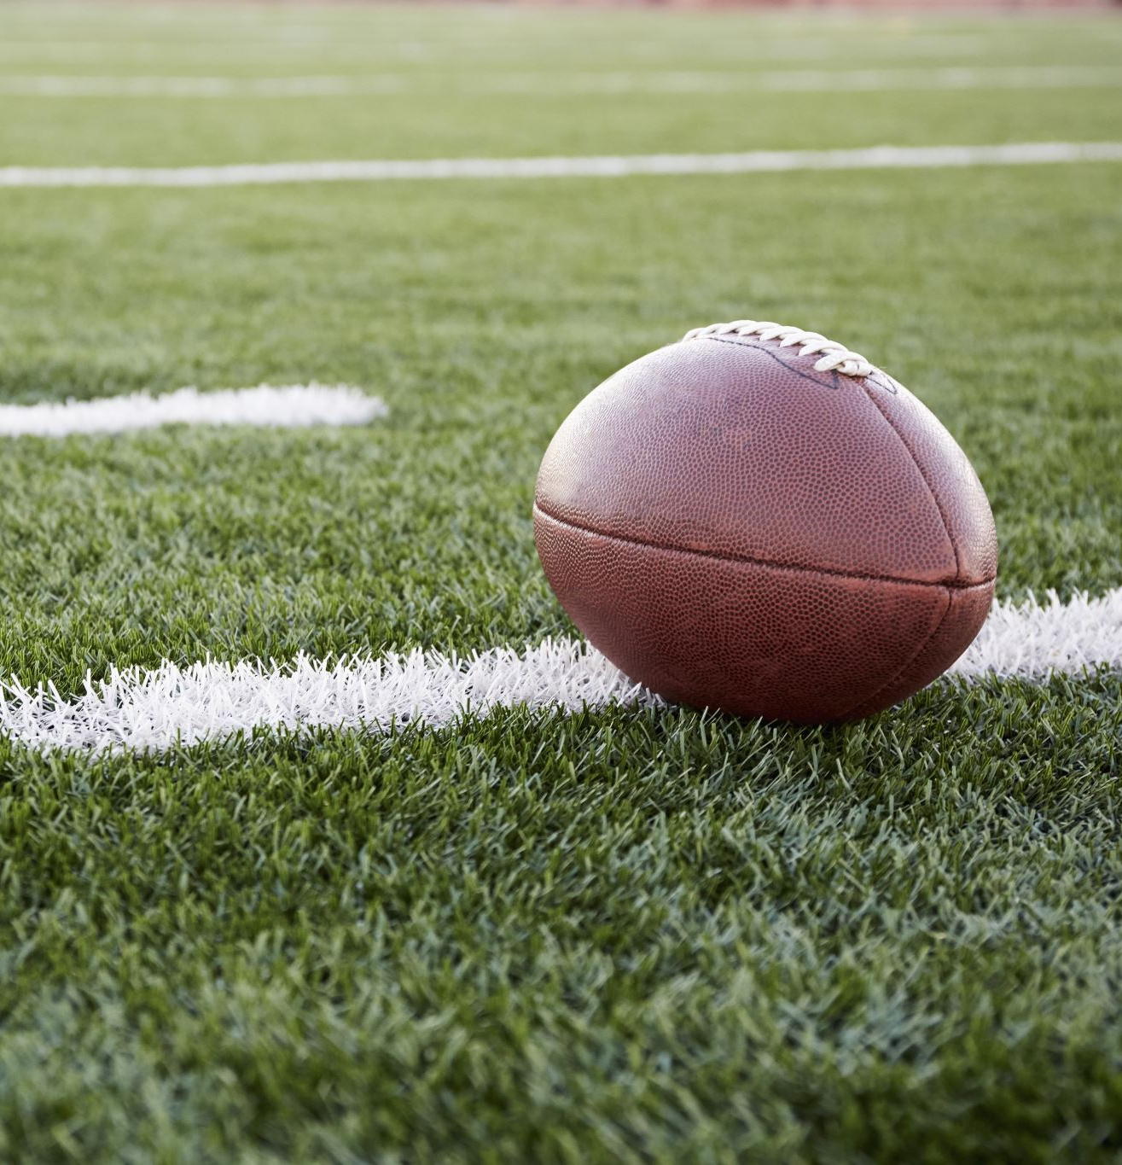
Conclusion
Prioritize the QB position
Throw the ball
Focus primarily on the outside of the field
Take size into consideration when evaluating RB’s

Slide 23

Thank you!
Questions?
https://www.linkedin.com/in/brett-fortuna215/

